Slide 1


Evaluating the impact of uncertainty in flame impulse response model on thermoacoustic instability prediction: A dimensionality reduction approach
Uncertain Input
S. Guo, C. Silva, A. Ghani, W. Polifke
Technische Universität München, Germany
Model
M. Bauerheim
Institut Supérieur de l’Aéronautique et de l’Espace, France
Uncertain Output
37th International Symposium on Combustion
PROCI-D-17-00939
Notes:
Good morning everyone, the work we present is about quantifying the variation of thermoacoustic instability predictions when uncertainties are contained in the flame impulse response model. This work was done by me and other co-workers in TU Munich and Michael Bauerheim from ISAE.

Slide 2
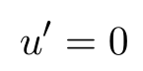
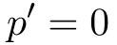
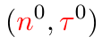
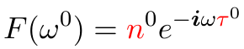

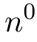
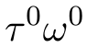
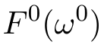
Flame model uncertainty needs to be considered for achieving more robust thermoacoustic instability prediction
Rijke tube:
,
Frequency
Acoustic
Solver
Imag
Growth Rate
Real
Notes:
When using acoustic solver to calculate thermoacoustic modes, uncertainties in the flame model is always an issue that we need to consider. Take Rijke tube and a n-tau model as an example. Let’s say we want to calculate the first thermoacoustic mode, we simply need to put this n-tau model into acoustic solver, and we can calculate the frequency and growth rate values. Correspondingly, we can plot the phasor of the flame frequency response F on this complex plane, with n0 being the length and tau0 omega0 being and angle. This is the deterministic way of thinking. In reality however, usually the values of n and tau are uncertain.

Slide 3
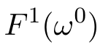
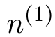
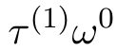
Flame model uncertainty needs to be considered for achieving more robust thermoacoustic instability prediction
Rijke tube:
,
Frequency
Acoustic
Solver
Imag
Growth Rate
Real
Notes:
And to visualize this uncertainty, our F phasor, which we always evaluate at omega0, may be here, with n1 and tau1.

Slide 4
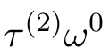
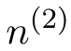
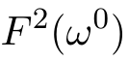
Flame model uncertainty needs to be considered for achieving more robust thermoacoustic instability prediction
Rijke tube:
,
Frequency
Acoustic
Solver
Imag
Growth Rate
Real
Notes:
or there, with n2 and tau2. Then, in order to quantify the impact of this flame model uncertainty on the thermoacoustic mode calculation, we need to do uncertainty quantification analysis, or UQ analysis.

Slide 5
Flame model uncertainty needs to be considered for achieving more robust thermoacoustic instability prediction
Rijke tube:
,
Frequency
Acoustic
Solver
Imag
Growth Rate
Real
Notes:
To do that, we use Monte Carlo method, we draw samples from the probability distribution of n and tau, so here, circles represent the F phasor of different n-tau combinations.

Slide 6
Flame model uncertainty needs to be considered for achieving more robust thermoacoustic instability prediction
Rijke tube:
,
Frequency
Acoustic
Solver
Imag
~1000
Growth Rate
Real
Notes:
We draw a lot of n-tau samples.

Slide 7
Flame model uncertainty needs to be considered for achieving more robust thermoacoustic instability prediction
Rijke tube:
,
Frequency
Acoustic
Solver
Unstable
~10000
Growth Rate
Real
Notes:
usually at the order of 10000, then we calculate the corresponding frequency and growth rate for each sample through acoustic solver, therefore we can obtain a converged histogram and probability density function, or PDF, for both frequency and growth rate. Usually we focus on the PDF of the growth rate, because it directly inform us about how risky for this mode to be unstable. When we do this, we found something interesting.

Slide 8
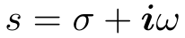
Flame model uncertainty needs to be considered for achieving more robust thermoacoustic instability prediction
Imag
Real
Real
Notes:
When we color those samples with their corresponding growth rate values, we see some patterns.

Slide 9
Growth rate contours are approximately parallel straight lines on the phasor plot of F for Rijke tube case
Imag
Imag
Real
Real
Notes:
To make this more clear, we single out several different levels of growth rate value from here. It turns out that, the growth rate contours are approximately straight parallel lines on the phasor plot of flame frequency response.

Slide 10
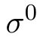
Growth rate contours are approximately parallel straight lines on the phasor plot of F for Rijke tube case
Rijke tube:
,
Unstable
Growth Rate
Real
Notes:
This is a vey exciting news for doing UQ, because once we capture this pattern, we don’t need acoustic solver anymore. Because for each sample of n and tau, we just need to do some geometric calculation to determine its F phasor belongs to which growth rate level, then immediately we can get its corresponding growth rate value and subsequently build a PDF.

Slide 11
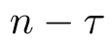
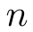
Understanding the distribution pattern of the growth rate contours constitutes the motivation for our current study
Questions:
What do growth rate contours look like in general?
Impulse Response
Imag
Time
Time
Real
Notes:
Inspired by this thought, we want to look deeper, we want to know, what do these growth rate contours look like on the phasor plot of F for general case: general combustor, general acoustic solver, and general flame model, like a flame impulse response model. Are they still straight lines? And how can we leverage this for faster UQ analysis. This question motivates our current study, and we want to solve it through analytical methods.

Slide 12
Presentation overview
Motivation
Visualization: from FIR to the phasor plot of FRF
Analytical Results: what do growth rate contours look like
UQ Strategy & Case Studies
Conclusions & Outlook
Notes:
The remaining of the presentation goes as follows: to begin with, I will say a few words on flame impulse response model and also set the stage for visualizing the results. Then we will dive into the analytical derivation, and I will demonstrate our analytical results. After that, I will show how to construct an UQ strategy based on the analytical results, and I will demonstrate its accuracy through case studies. Finally, I will summarize the main conclusions and possible extensions of our current work.

Slide 13
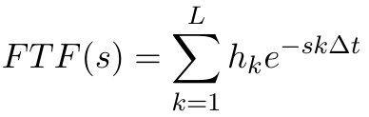
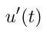
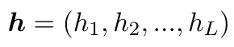
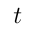
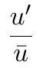
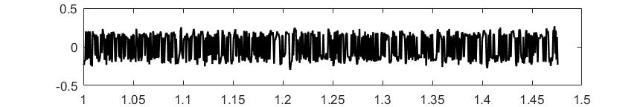
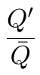
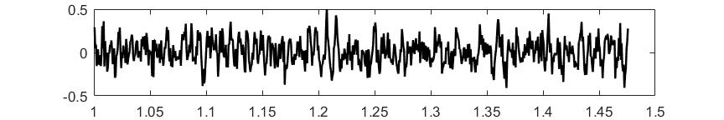
Flame impulse response is a flexible representation of realistic flame dynamics in time domain
Impulse Response
Flame Model
Flame
Amplitude
+
Acoustic Solver
0
System Identification
Notes:
Ok, let’s start with the flame impulse response model. Flame impulse response is a time-domain model, physically it describes the heat release rate response of the flame under an impulse velocity excitation at a reference position upstream of the flame. Flame impulse response represents a more realistic flame model. Through Laplace transform, it can be easily converted to flame transfer function. Here, hk’s are these non-zero stems, and we can simply write those coefficients as a vector. Flame impulse response model can be identified via unsteady CFD simulation.

Slide 14
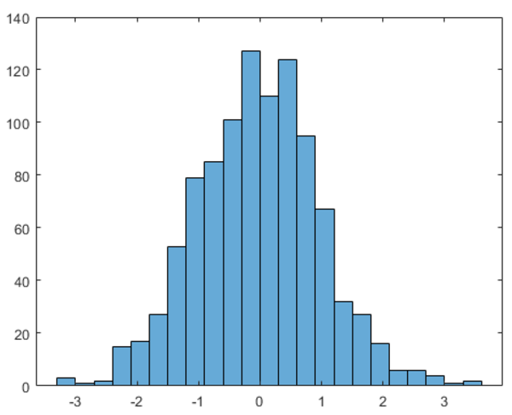
Flame impulse response identification contains uncertainty, which will influence the growth rate prediction
Impulse Response
Flame Model
Flame
Amplitude
+
Acoustic Solver
0
Time
?
PDF
System Identification
Growth Rate
Notes:
However, due to uncertainties in CFD simulations, limited length of this time series, the identification won’t be perfect and will contain uncertainty too, represented by the confidence interval for each coefficient. Those uncertainties can propagate through acoustic solver, our predicted growth rate values will also be uncertain. Therefore, we need to find a way to quantify this variation. Actually this is a very challenging task because impulse response model usually has 15-30 parameters, the computational cost for this high dimensional problem will be very high due to the so-called “curse of dimensionality”.

Slide 15
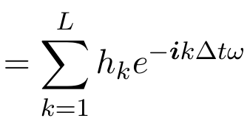
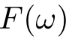
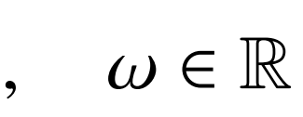
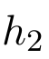
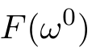
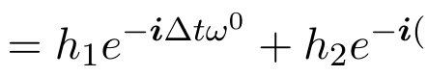
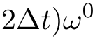
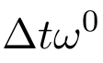
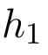
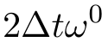
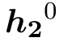
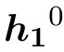
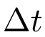
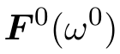
Results visualization: phasor plot of flame frequency response
Frequency
Response
Impulse
Response
Example:
Im
Re
Amplitude
Time
Notes:
Flame impulse response can be easily translated into the phasor plot of flame frequency response, which will be used for results visualization throughout our whole study. let’s see an example. First, we recognize this relation, which converts flame impulse response, with hk’s being the coefficients, to flame frequency response. Then, say we have a simplified FIR model with only two coefficients, h1 & h2, and we can write F at a fixed nominal frequency like this. Both terms are complex numbers. So we can draw h1 like this, and h2 like this. Add them together, we can draw F like this. Now, when h1 & h2 are uncertain, any variation of h1 & h2 will change their corresponding length. Consequently, length and direction of the resulting F phasor will also change. One thing to keep in mind is, no matter how h1 and h2 are changing, we always plot F phasor at this nominal frequency, which is calculated by putting nominal h1 and h2 into acoustic solver. The reason why we do this will be clear later of the presentation. So here is just an example with 2 coefficients, in the following study, we don’t restrict the number of coefficients.

Slide 16
Presentation overview
Motivation
Visualization: from FIR to the phasor plot of FRF
Analytical Results: what do growth rate contours look like
UQ Strategy & Case Studies
Conclusions & Outlook
Notes:
After introducing the results visualization framework, let’s start our analytical analysis.

Slide 17
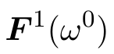
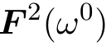
Analytical derivation: An overview
Im
Geometric Relation?
Re
Goal
Notes:
Here is just an overview. Our goal is, we want to find out, for any two samples of impulse response coefficients, if they yield the same growth rate, then what is geometric relationship between their corresponding F phasor? In other words, we want to know the pattern of growth rate contours on the phasor plot of F.

Slide 18
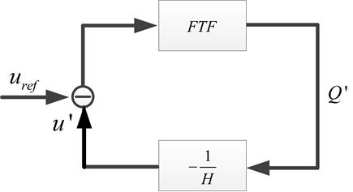
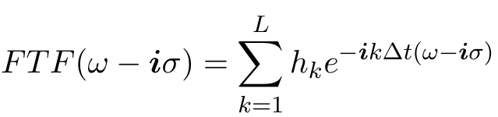
Analytical derivation: An overview
Im
Geometric Relation?
Re
Goal
Assumption
Uncertainty is not large
Marginally stable mode
Method
First-order analysis
Notes:
We started from the fundamental characteristic equation of the thermoacoustic feedback loop, where FTF describes the flame transfer function and H represent the acoustic transfer function. We choose a flame impulse response model with arbitrary number of coefficients. We had two assumptions, the first one is the uncertainty of hk’s should not be large. I will show what large means in our case study. The second one is the mode under consideration should be marginally stable, the nominal growth rate should be close to zero. Then, we performed a first-order expansion analysis on this equation.

Slide 19
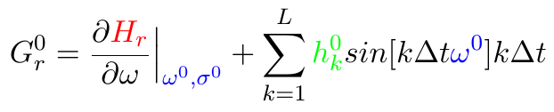
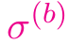
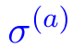
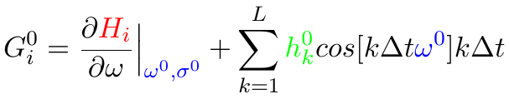
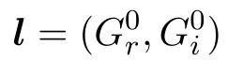
To first order, the growth rate contours are parallel straight lines on the phasor plot of F
Im
Re
This direction is determined by:
FIR model
Acoustic transfer function
Thermoacoustic mode
Notes:
And what we found out, is that, to first order, for any two samples of impulse response coefficients, if they produce the same growth rate value, then their corresponding F phasors are on a straight line. And at a different level of growth rate, these lines are in parallel. We can derive the analytical expression for this direction. Here we can see that, the components of this direction are determined by, first, the nominal values of the impulse response model; second, acoustic transfer function H, this is the real part and this is the imaginary part. And finally, the specific thermoacoustic mode under investigation.

Slide 20
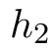










Analytical results can be leveraged to deliver a dimensionality reduction UQ strategy
Im
Re
Amplitude
Time
Notes:
Then next step is, how can we leverage this analytical results for our UQ analysis? Let’s go back to this simple example. Now since we know the growth rate contours are straight lines, then we can see that, each coefficient’s variation can modify growth rate individually, but what ultimately determines the growth rate change is the sum of their projection on this gradient direction. We denote this projection sum as Y, which is simply a linear combination of all the IR coefficients.

Slide 21


Analytical results can be leveraged to deliver a dimensionality reduction UQ strategy
Im
Re
Amplitude
Time
Dimensionality Reduction!
Notes:
Once we recognized this, then perform UQ analysis becomes much easier. The only thing we need to do is to relate a specific value of Y to a specific value of growth rate. In practice, we can simply fit a polynomial function. Once we have done that, we can quickly calculate the growth rate for any IR coefficient sample. This is essentially a dimensionally reduction strategy, because all the contribution by hk’s can be lumped into one single variable Y, so the problem dimensionality shrinks from L to just 1.

Slide 22







A dimensionality reduction UQ strategy leveraged on the distribution pattern of the growth rate contours
Im
Calculate
and
1
Re
Calculate the gradient direction
2
Im
3
Fit a polynomial function
Re
,
Notes:
Based on the previous discussion, we propose the following UQ strategy to efficiently propagate uncertainties from impulse response to growth rate prediction. First step, we calculate the nominal frequency and growth rate by using the nominal IR model. Next, we calculate the gradient direction of the growth rate contours on the phasor plot of F, based on this formula. Here, for this term, either we can compute by finite difference approximation, or if we use acoustic network model, then these terms are known analytically. Then step three, the goal here is to fit a function to describe the relation between Y and growth rate sigma.

Slide 23






A dimensionality reduction UQ strategy leveraged on the distribution pattern of the growth rate contours
Im
Calculate
and
1
Re
Calculate the gradient direction
2
Im
3
Fit a polynomial function (5~10 samples)
Re
,
Monte Carlo simulation
4
Notes:
In order to do that, we can draw several samples of IR coefficients from their distribution, usually between 5-10, calculate their corresponding F phasor and determine their Y values, and use acoustic solver to calculate their corresponding growth rate values. Therefore, we can easily fit a polynomial function to relate Y and growth rate. Finally, we are ready to perform UQ analysis. We draw a large number of samples of IR coefficients, through this algebraic calculation, we can immediately obtain the PDF of the growth rate.

Slide 24



Case study: acoustic network model, impulse response identification and thermoacoustic mode specification
Stable
Unstable
Notes:
So how is this UQ strategy performed on a real combustor? Let’s go through a case study. We investigates a turbulent premixed swirl burner. For this case study, we choose acoustic network model as our acoustic solver. Flame dynamics is described by a impulse response model, which is identified through real LES simulation of this combustor. It has 16 coefficients, through identification, we will not only obtain their nominal values, but also the correlations between each pair of coefficients, represented here by a covariance matrix. This uncertainty level is large, because the maximum ratio between coefficient standard deviation and coefficient mean can be as large as 130%. So we can really test our UQ strategy. We consider two cases, case A and case B, they have different values of combustor length and reflection coefficient on the combustor outlet. The dominant modes for both cases are shown here, which are calculated by using the nominal value of IR coefficients. Those two cases are particularly interesting, because they are very close to the stability limit and may become unstable when taking into account the uncertainty in flame model.

Slide 25

Our UQ strategy replicated the reference Monte Carlo results with 5000 times less computational cost
Monte Carlo: 30000 acoustic network calculations
Computational Cost:
Our strategy: 1+5 acoustic network calculations
Notes:
Here we compare the PDF of the growth rate predicted by our UQ strategy with the reference Monte Carlo method. The results match pretty well. And in terms of the computational cost, our strategy only costs 6 times acoustic solver calculations, which is one time nominal value calculation and 5 times more calculations to fit a second order polynomial between the projection sum Y and the growth rate. So the efficiency improves a lot.

Slide 26


Conclusion & Outlook
Im
1
Sensitivity Analysis
Re
Im
Re
2
Re
Notes:
Ok, to summarize our current work: first, we confirmed the pattern we observed in the simple Rijke tube and n-tau model case, and analytically proved that, to first order, growth rate contours are parallel straight lines on the phasor plot of flame frequency response. Based on that, we proposed an UQ strategy, which can shrink the problem dimensionality to just one, therefore significantly accelerated uncertainty propagation from flame response model to the growth rate prediction. In addition, our current results can be further exploited in, for example, sensitivity analysis, since we notice that, depending on these angles, different coefficients have different ability to modify the growth rate. This is a natural measurement for the sensitivity of growth rate variation against each coefficient’s variation.

Slide 27
Conclusion & Outlook
Im
1
Robust Design
Re
Im
Re
2
Re
Notes:
Second, robust design. We can tune our combustor, therefore changing this gradient direction, so that the projection sum of those coefficient variations is minimized. By doing that, we can make our growth rate prediction insensitive to the uncertainties in the flame model. So that concludes my presentation, thank you very much for your attention.

Slide 28
Back-up slides

Slide 29



The assumption of marginal stable mode

Slide 30


Growth rate contours for BRS burner
Case A
Case B

Slide 31


For each case, a quadratic function is fitted to link Y to modal growth rate
Case A
Case B

